Slide 1
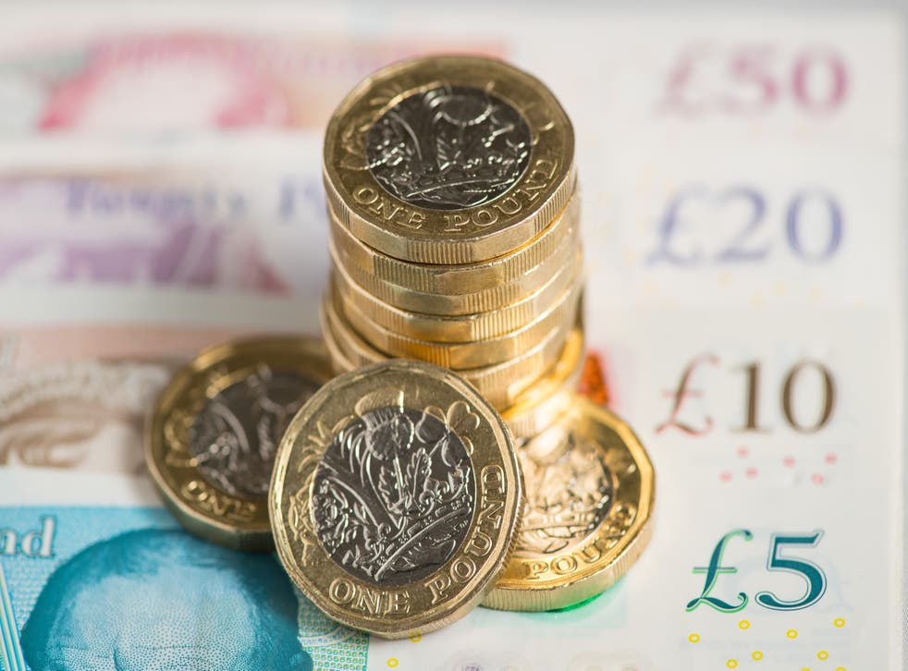
Green Money Matters

Slide 2
“It might not be the most obvious way of reducing your carbon footprint, but how you save, invest and give away your money can make a difference to the climate.”

Slide 3
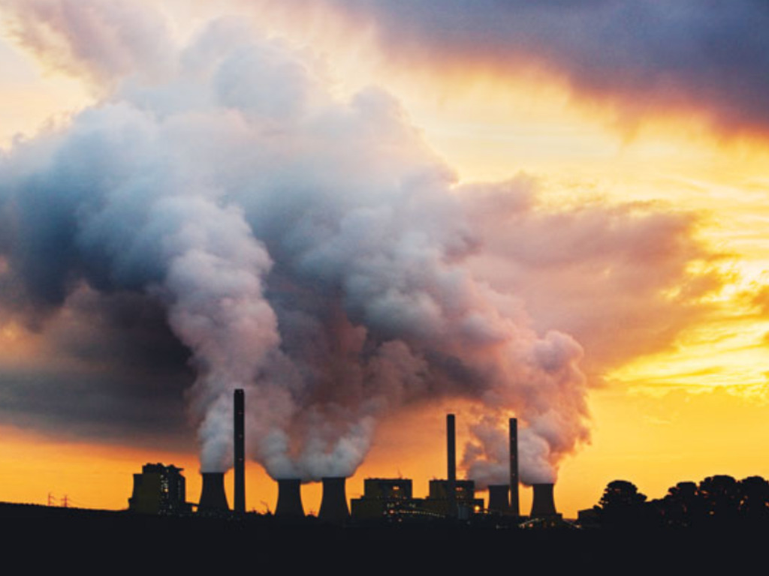
The UK is the world’s third-largest lender to coal industry companies. (2019)

Slide 4
Big banks are pumping billions into new oil and gas production despite net zero pledges, campaigners have said.
Banks including HSBC, Barclays and Deutsche Bank are still backing new oil and gas despite being part of a green banking group, say ShareAction.
Investors should force banks to demand green plans from fossil fuel firms before funding them, it said.
BBC Report – 14/02/2022

Slide 5
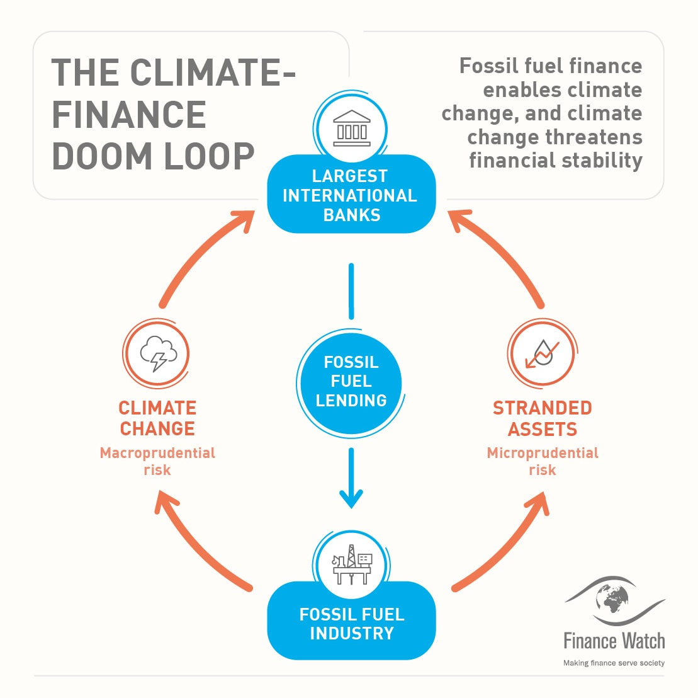

Slide 6
UK Banks that fund fossil fuels 2016 - 2019
Barclays = £90.94BN
HSBC = 66.63BN
Standard Chartered = £18.49BN
Santander = 19.82 BN
RBS = £9.33BN

Slide 7
UK Based Ethical Banks
Triodos – ”to make money work for positive social, environmental, and cultural change”
Nationwide – “chooses its investments based on ethical principles & has a long history of ethical practices”
Engage – “does not invest your money or deal with companies that trade in arms dealing or harmful substances such as tobacco and alcohol”
Starling – “focusses on the environment and furthers the pursuit of environmental sustainability and the goal of combating climate change”

Slide 8
'Financing our own extinction‘
"Harmful subsidies must be redirected towards protecting the climate and nature, rather than financing our own extinction.“
Christiana Figueres, former executive secretary of the UNFCC and B Team leader

Slide 9
What can we do?
1. Learn more about where our money is invested
2. Change to an ethical bank
3. Write letters & emails
4. Spend our money ethically
5. Share Ideas

